Slide 1

Car Dealership System
AbdelRahman Ammar 202102787
Abdelrhman Fouda 202101892
Hassan Ghataty 202103095

Slide 2
Introduction
Project Problem Statement
The current car dealership operations lack an efficient, digital system to manage customer interactions, inventory tracking, and user role-specific functionalities. Manual processes are error-prone, time-consuming, and limit scalability.
Summary
The Car Dealership System is a web-based solution designed to streamline operations for car dealerships. It provides:
Role-based access for Admin, Salesperson, and Customer.
Inventory management with real-time updates.
Test drive scheduling, car bookings, and inquiry tracking.
Comprehensive sales reporting and database-driven functionality.

Slide 3
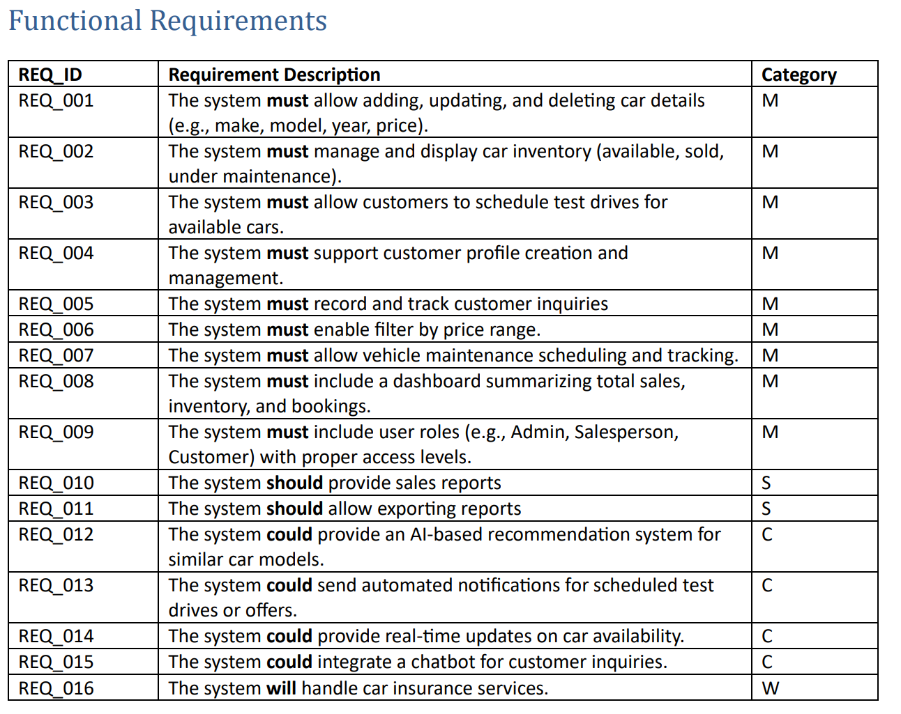

Slide 4
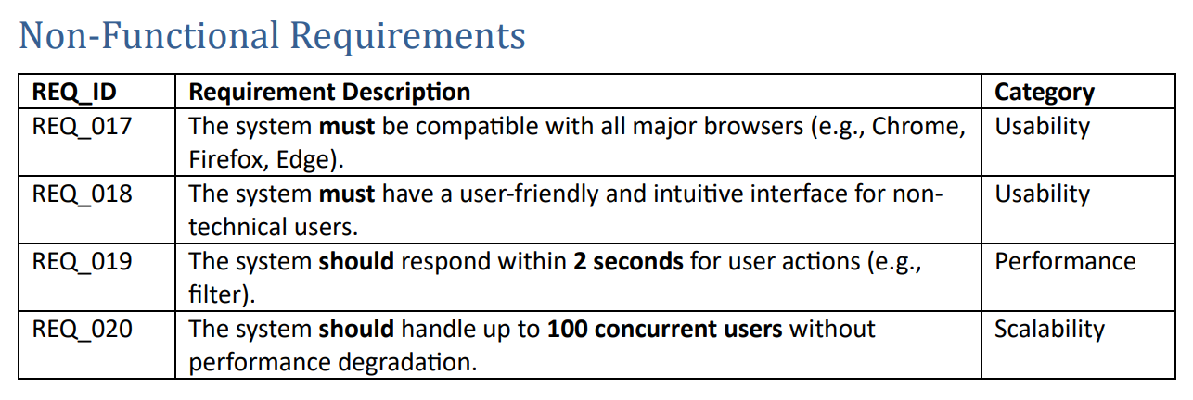

Slide 5
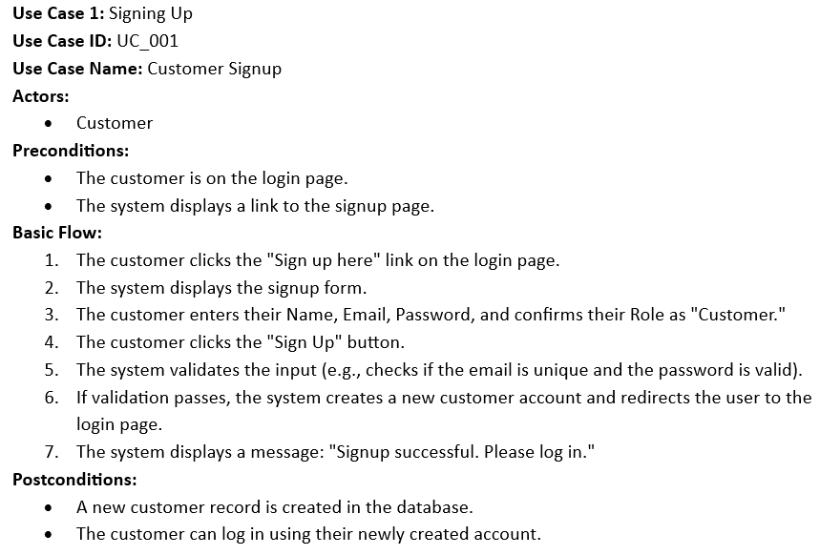
Use Case 1

Slide 6
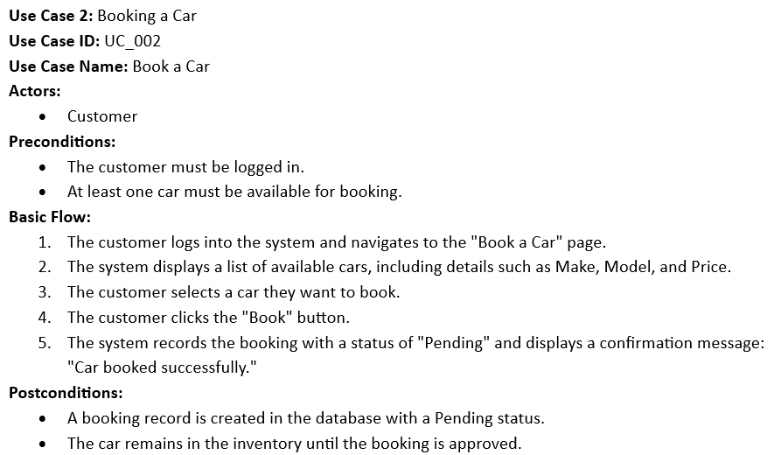
Use Case 2

Slide 7
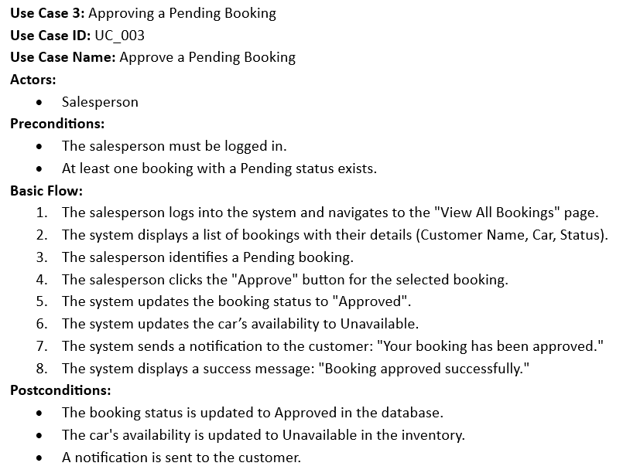
Use Case 3

Slide 8
Entity-Relationship Diagram

Slide 9
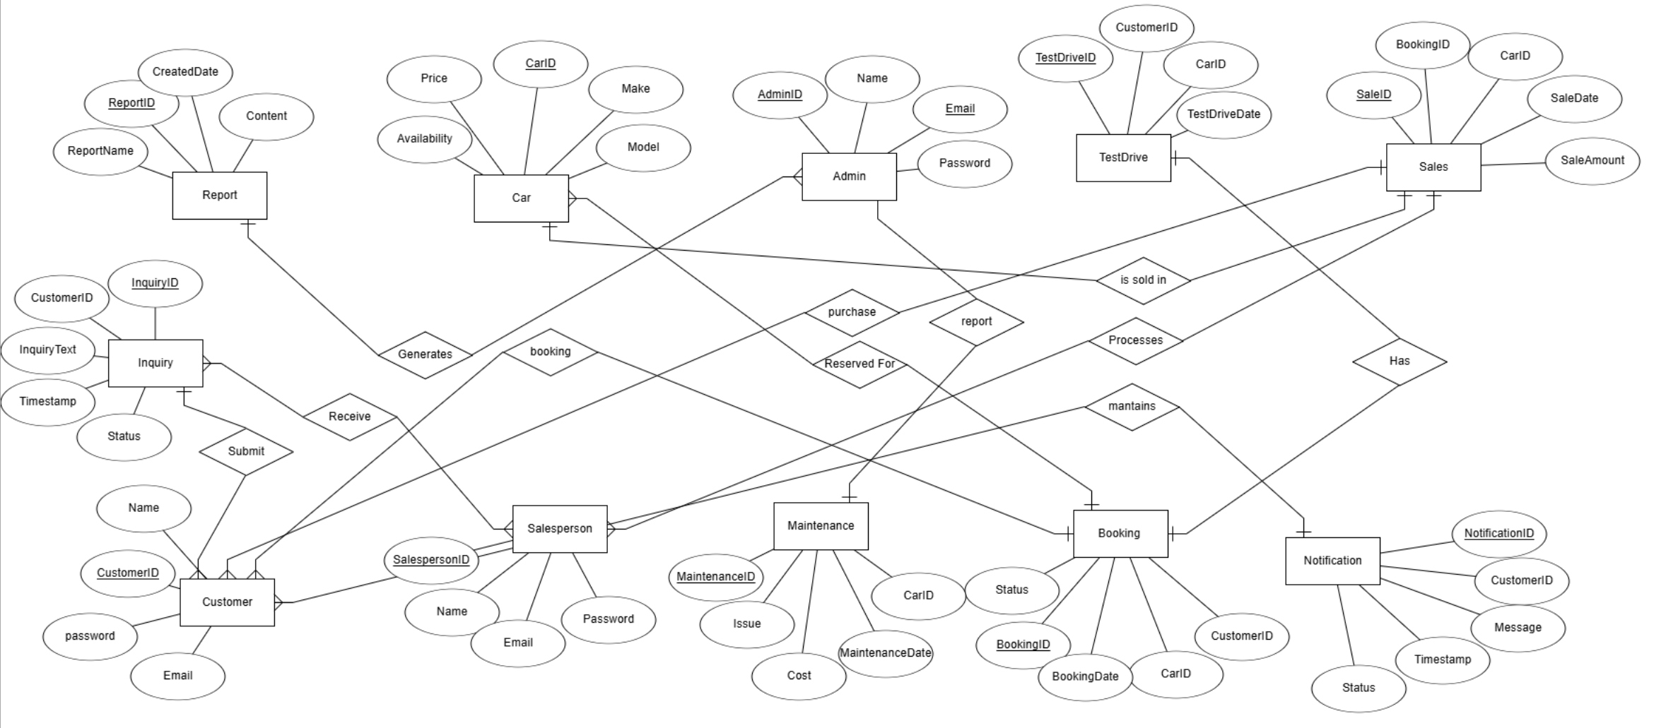

Slide 10
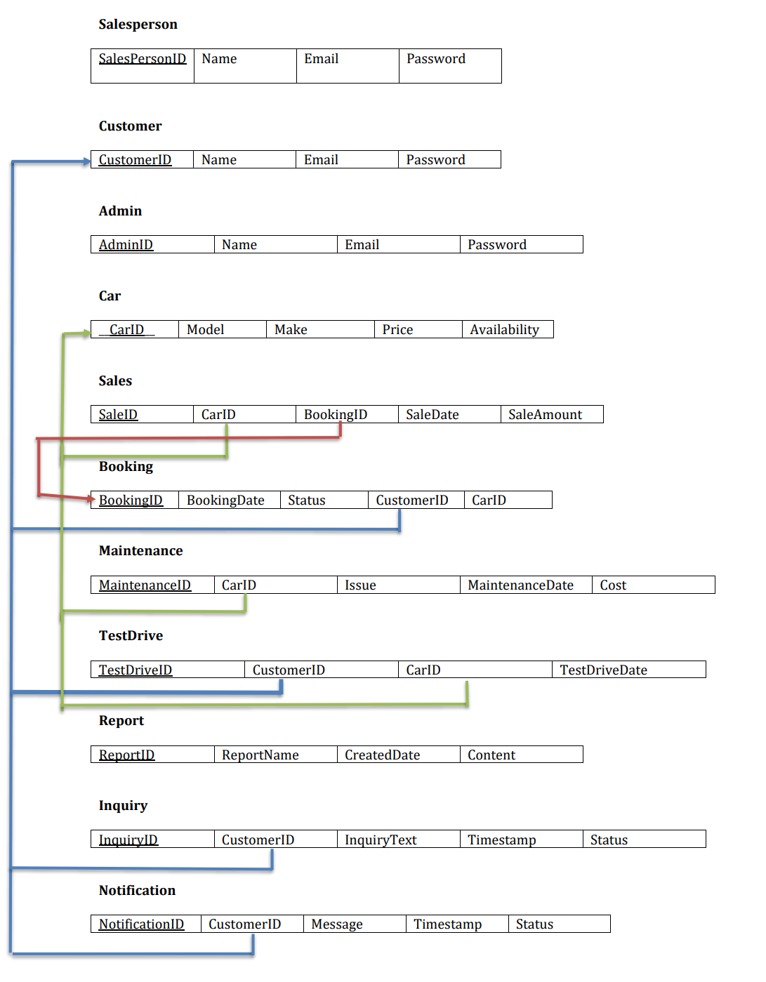
Relational Database Schema

Slide 11
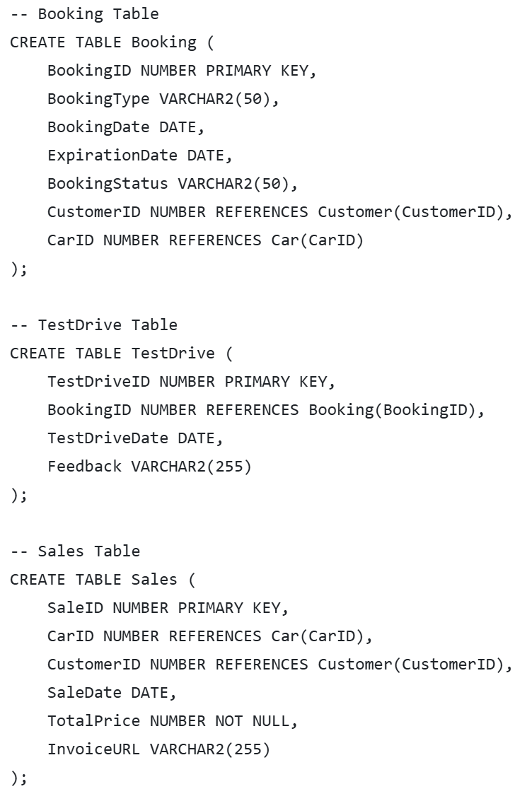
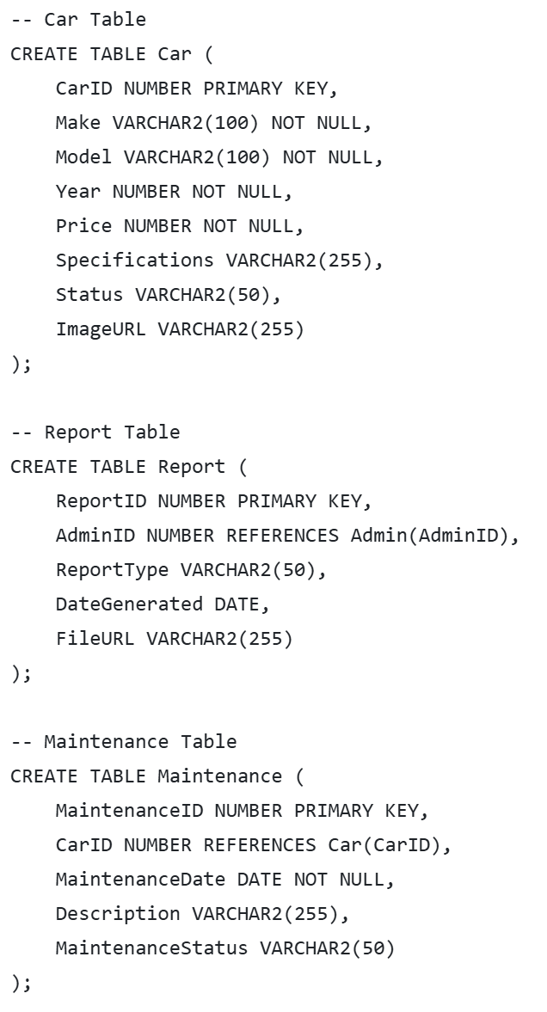
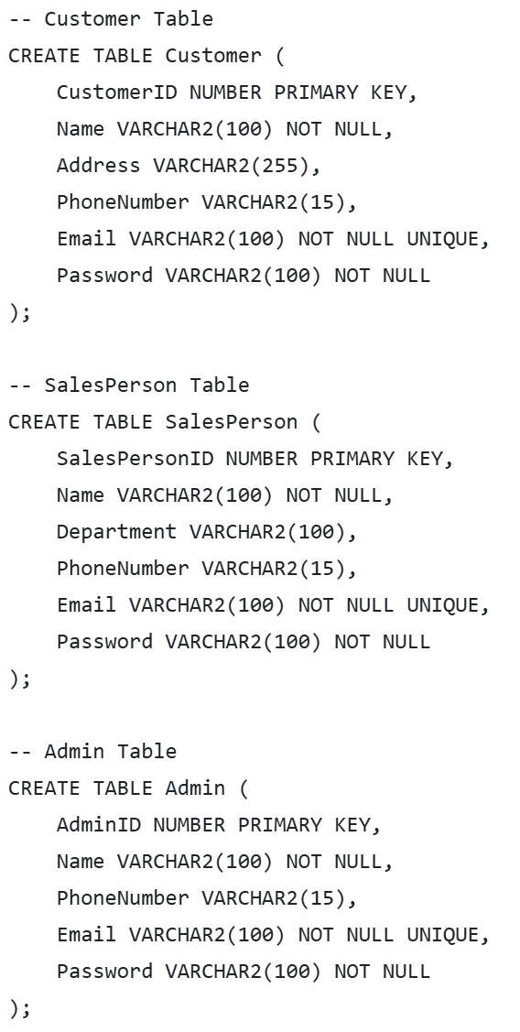
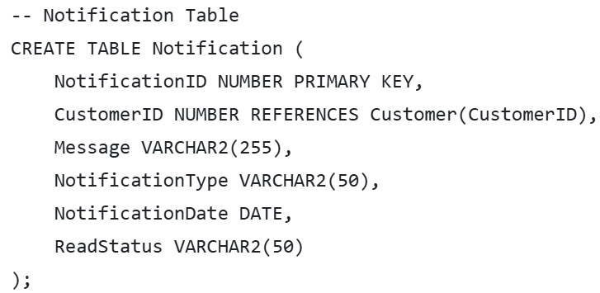
SQL Queries: CREATE

Slide 12
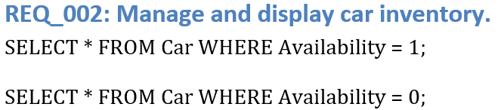
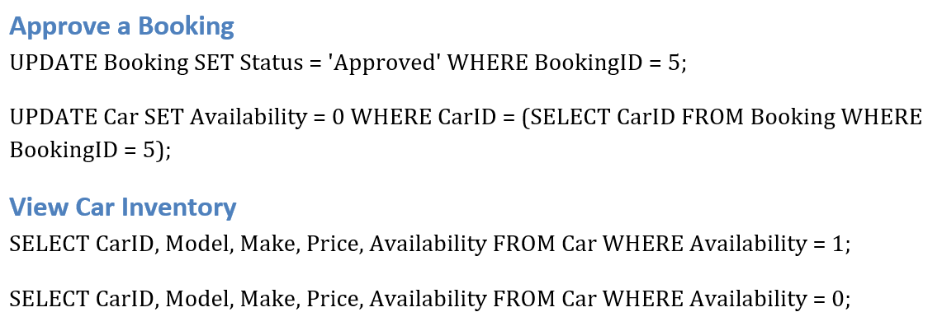
SQL Queries

Slide 13
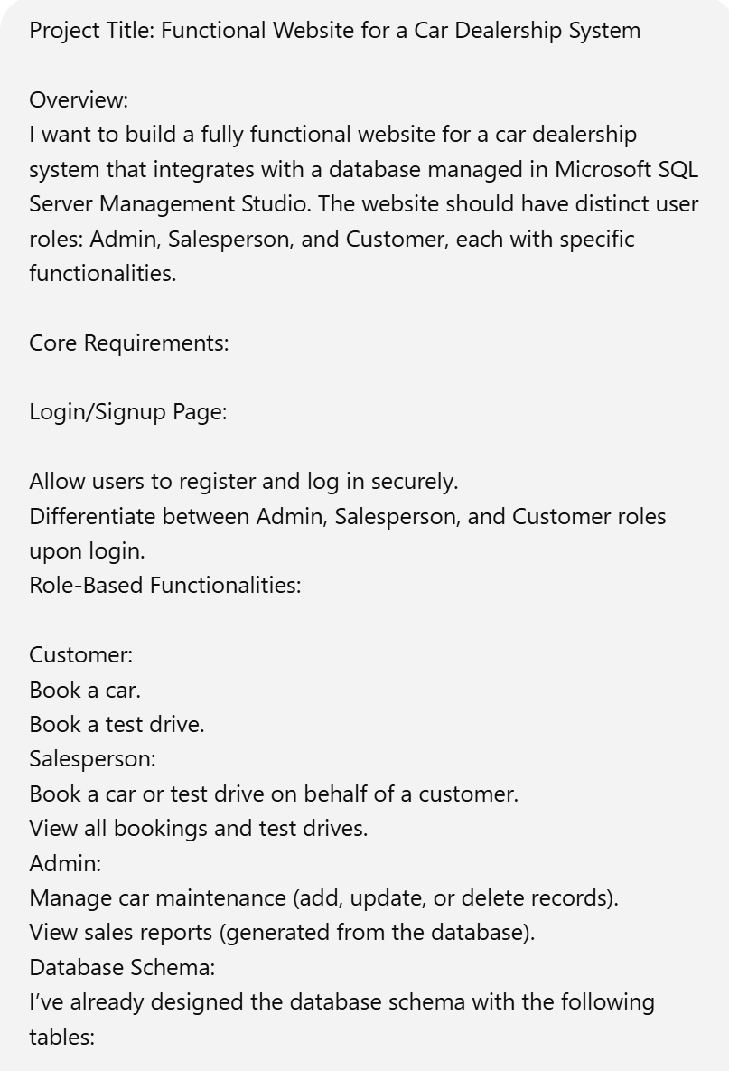
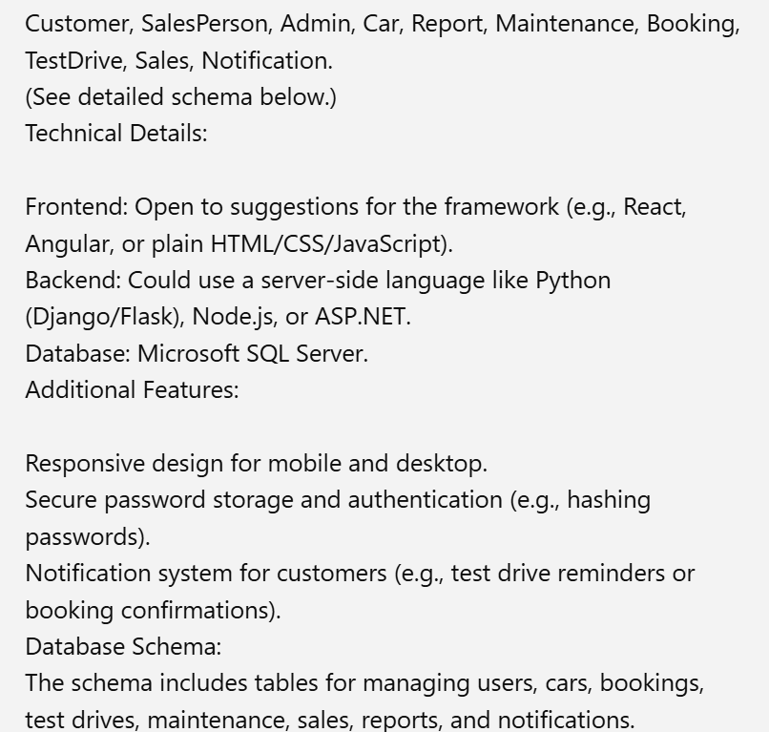
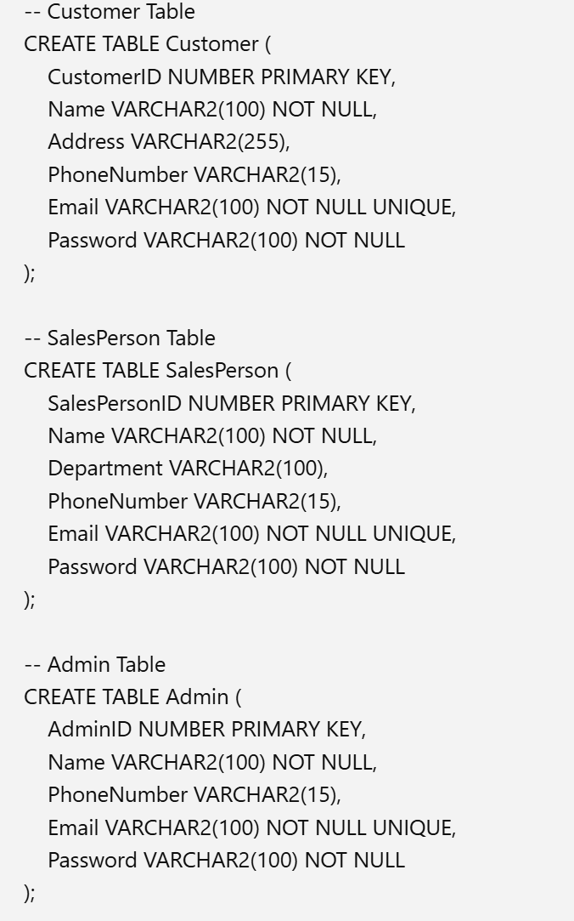
Initial Prompt:

Slide 14
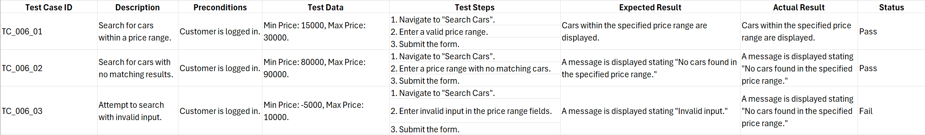
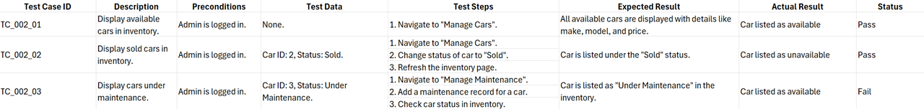
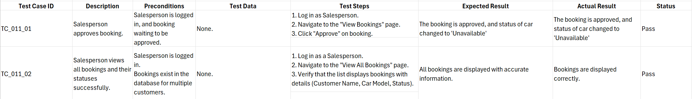
Test Cases

Slide 15
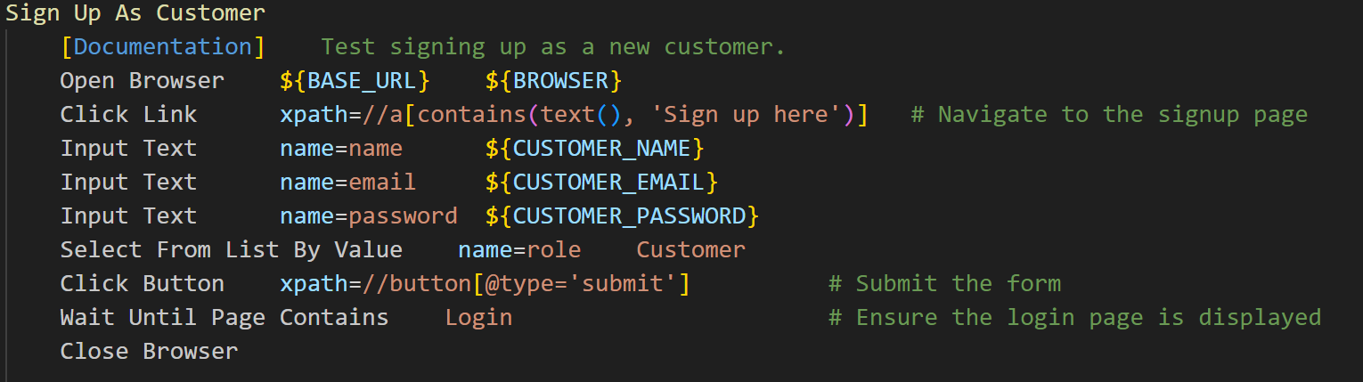
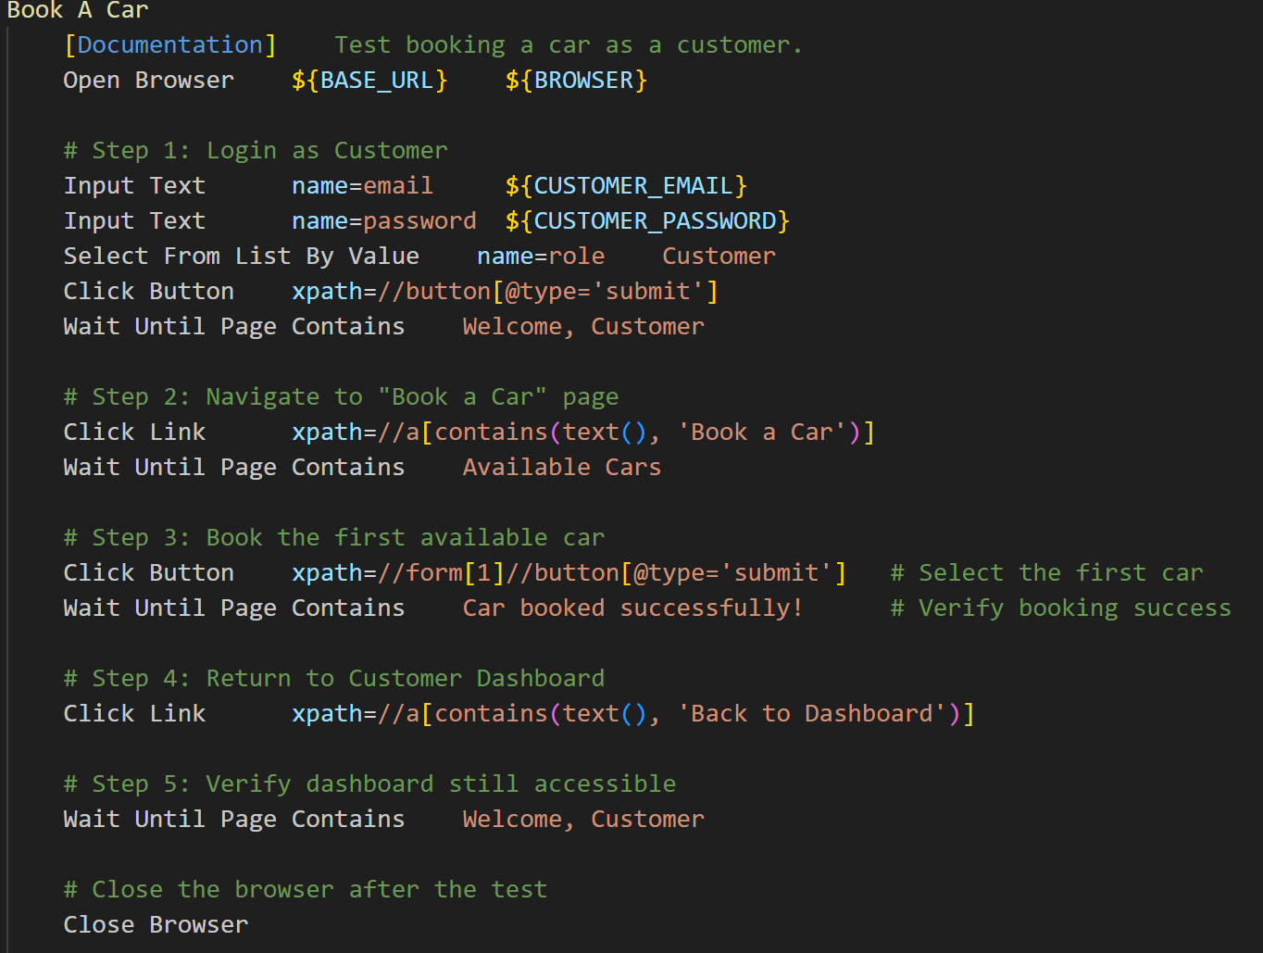
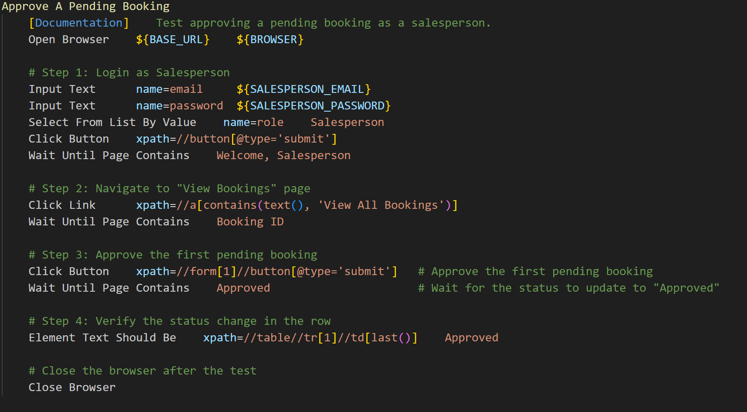
Automated Test Cases

Slide 16
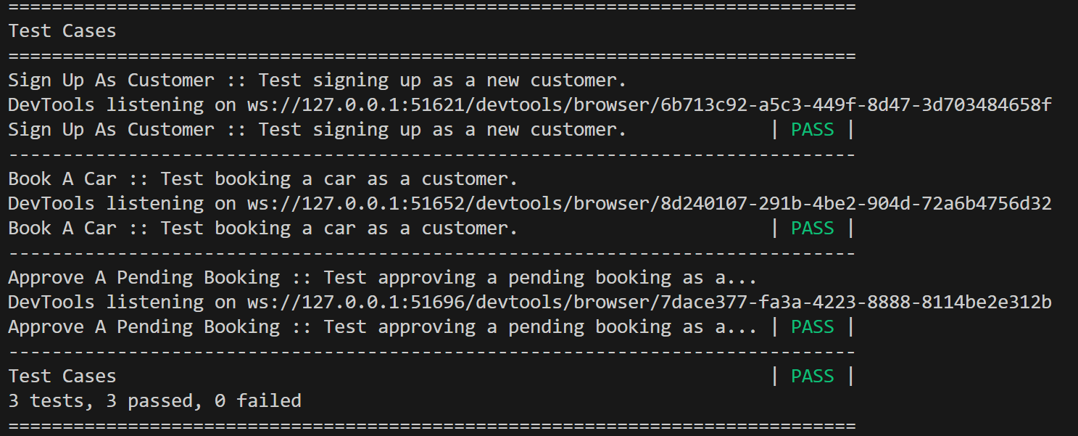
Results

Slide 17

Challenges Faced and Solutions

Slide 18
What Would You Do Differently?
Adopt a Frontend Framework
Change: Use a modern frontend framework like React or Angular to improve user experience and make the design more dynamic.
Reason: The current HTML/CSS implementation is functional but lacks interactivity and scalability for larger applications.
Enhance Security
Change: Implement password hashing (e.g., bcrypt) and HTTPS to further secure user data.
Reason: Plain-text password storage in the database is a security risk and should be avoided.
Optimize Testing:
Change: Increase test automation coverage and integrate a CI/CD pipeline for continuous testing and deployment.
Reason: Automating more workflows would save time and reduce human errors during testing.

Slide 19
What Would You Do the Same?
Flask for Backend:
Keep: Use Flask for its simplicity and flexibility.
Reason: It allowed for rapid development and easy integration with the database.
Role-Based Access Control:
Keep: The current role-based access control implementation.
Reason: It effectively ensured users only accessed functionalities relevant to their roles.
Relational Database Design:
Keep: The normalized database schema.
Reason: It provided clear relationships between entities and supported efficient querying.

